Slide 1
Networking for Software Developers
Lecture 6 – Part I – Summer 2024

Slide 2
Agenda
Telnet
FTP

Slide 3
Teletype Network (Telnet)

Slide 4
Telnet
Application protocol that facilitates bidirectional interactive text-oriented communication between two nodes over TCP/IP
Predated TCP/IP and originally over Network Control Protocol (NCP)
Consist of two components:
Protocol specifying the communication between two nodes
Software or service that facilitates the communication
Operates on Port 23 or 2323
Does not employ encryption (e.g., usernames and passwords in plaintext during transit)

Slide 5
Telnet Use Cases
Support a variety of functions:
Access public data
Edit files
Run and manage programs
Check emails
Debug network services (e.g., SMTP, IRC, HTTP, FTP, POP3, etc.)

Slide 6
Telnet Connection
Connection process includes:
Use telnet command with hostname and port information to initiate the connection
telnet <<hostname/IP>> <<port>>
Execute commands on the node with specific commands into the Telnet prompt
End session and log off

Slide 7
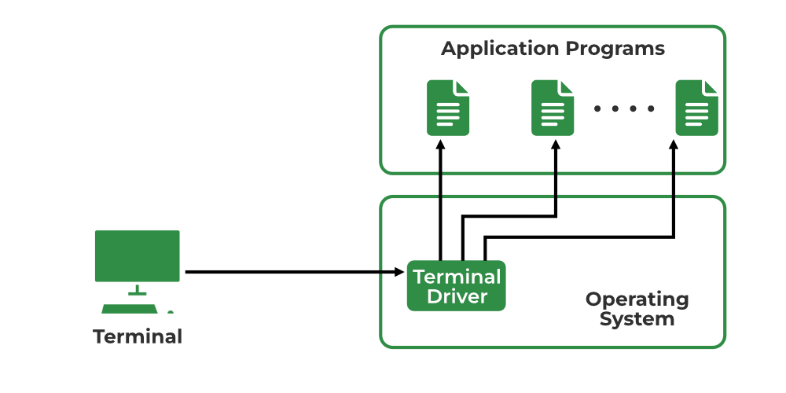
Telnet – Local Login

Slide 8
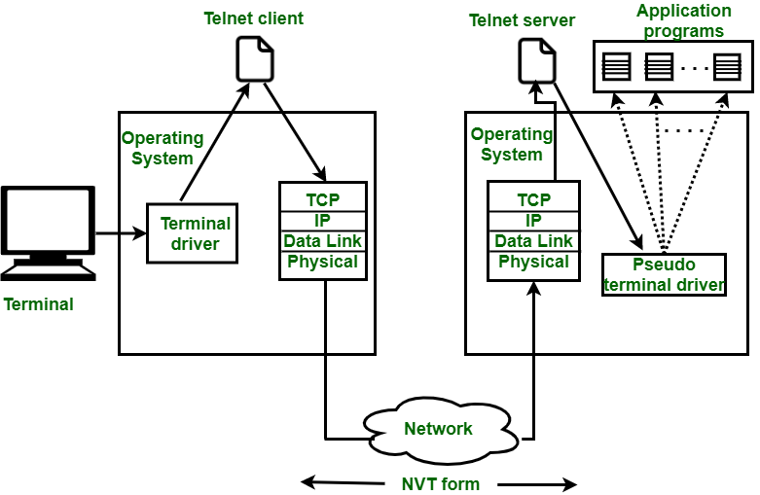
Telnet – Remote Login

Slide 9
File Transport Protocol (FTP)

Slide 10
FTP
Application protocol that facilitates file transfers between two nodes (e.g., local and remote hosts) over TCP/IP
Predated TCP/IP and originally over Network Control Protocol (NCP)
Designed based on client-server architecture model with two communication channels :
Command (or control) channel – initiates the instruction and response
Data channel – facilitates the distribution of data
Operates on Port 21 and 20 **

Slide 11
FTP
No encryption support and blocked by many entities
Replaced with newer protocols:
FTP Secure (FTPS)
File Transfer Protocol over explicit TLS/SSL (FTPES)
SSH or Secure FTP (SFTP) – Port 22 **

Slide 12
FTP Connection
Communication and data transfer process supported via:
FTP client – application available on client nodes that communicates with FTP servers
FTP server – physical nodes and software components that are responsible for file storage and sharing across networks (i.e., internet)
Connection typically requires credentials to the servers
Servers may allow all or portion of its content available without a login via anonymous FTP

Slide 13
FTP – Active Mode
Client (from a random Port) connects to Port 21 on server via command channel using the PORT command
Client specifies the port for data channel
Client
Server
Server connects (from Port 20) to the designated port on the client for the data channel
File transfers between client and server via the data channel

Slide 14
FTP – Passive Mode
Client (from a random Port) connects to Port 21 on server via command channel using the PASV command
Server responds with a port for data channel
Client
Server
Client connects (from random port) to the designated port on the server for the data channel
File transfers between client and server via the data channel

Slide 15
FTP Use Cases
Support a variety of functions:
Backups
Replications
Access and data loading
Commit code and configuration

Slide 16
FTP – Data Types
Data types supported for file transfers:
ASCII (TYPE A)
Image (TYPE I)
EBCDIC (TYPE E)
Local (TYPE L n)
Unicode (TYPE U)

Slide 17
FTP – File Structures & Data Transfers
Support for file organization approaches or structures:
FILE structure (stream-oriented)
RECORD structure (record-oriented)
PAGE structure (page-oriented)
Support for data transfer modes:
Stream mode (MODE S)
Block mode (MODE B)
Compressed mode (MODE C)

